Slide 1

FINAL REVIEW AI-Driven Dynamic Fuzz Testing for IoT Security Project Category : RESEARCH
Panel No. 06 Supervisor Name Dr. Balaji Srikaanth P, AP/NWC Dr. S. Nagendra Prabhu, AP/CINTEL | Batch No. NW000156 Shaurya Singh Srinet – RA2111032010006 Shounak Chandra – RA2111032010026 Charvi Jain – RA2111047010113

Slide 2
ABSTRACT
Distributed denial of service (DDoS) attack severely impacts IoT network capabilities and expose the infrastructure to numerous security problems.
DDoS attacks disrupt IoT networks; creating security vulnerabilities.
Dynamic Fuzz Test + GNN framework for real-time DDoS detection and mitigation.
NS-3 simulations generate realistic traffic for training the GNN model.
Achieves effective DDoS mitigation with minimal impact on network performance.

Slide 3
INTRODUCTION
IoT Security Challenges: The surge in IoT devices introduces significant vulnerabilities, demanding robust security measures.
Sophisticated Threats: DDoS and MITM attacks increasingly exploit IoT's interconnected nature, making traditional defenses inadequate.
Necessity for Innovation: Evolving cyber threats call for advanced security strategies, beyond the reach of conventional methods.
AI-Driven Solutions: Leveraging AI and ML, particularly Graph Neural Networks and dynamic fuzz testing, to enhance IoT threat detection and response.
Project Aim: Integrating AI-driven dynamic fuzz testing with GNN-based detection to provide real-time, effective security for IoT networks.

Slide 4
SCOPE AND APPLICATION
Diverse IoT Environments: Applicable across smart homes, healthcare, industrial IoT, and beyond.
Advanced Security: Improves the detection and mitigation of DDoS and network-based attacks within these varied IoT environments.
Scalable Solutions: Offers adaptable security measures suitable for large-scale IoT deployments, ensuring comprehensive protection.
Real-Time Response: Enables real-time detection and response, enhancing resilience across extensive IoT networks.
Research and Development: Provides a foundation for further exploration in IoT security, integrating AI-driven techniques and dynamic fuzz testing.

Slide 5
LITERATURE SURVEY
Fuzz Testing for IoT Security Authors: M. Böhme, et al. Journal: ACM Transactions on Privacy and Security Year: 2024
Method: Simulates real-world attack scenarios to comprehensively evaluate IoT security solutions.
Results: The fuzz testing method uncovered potential weaknesses in IoT systems by mimicking attack conditions.
Strengths: Provides a robust testing environment, improving the detection of vulnerabilities in IoT devices.
Conclusion: Fuzz testing enhances IoT security by exposing vulnerabilities, offering a practical tool for strengthening device resilience.

Slide 6
LITERATURE SURVEY
GNN-based Anomaly Detection for Securing IoT Networks Authors: X. Zhang, et al. Journal: IEEE Transactions on Network and Service Management Year: 2023
Method: GNNs model network structures, where nodes represent devices and edges signify data flow, to detect abnormal traffic patterns.
Results: GNNs demonstrated high accuracy in identifying distributed attacks by capturing both local and global network relationships.
Strengths: GNNs are adaptable to dynamic IoT environments and can detect complex patterns that traditional methods miss.
Conclusion: GNN-based anomaly detection offers a scalable and effective solution for securing IoT networks against evolving threats.

Slide 7
Sr. No. | Paper Name | Year Published | Journal Name | Methodology
1. | Fuzz Testing for IoT Security | 2024 | ACM Transactions on Privacy and Security | The paper presents a fuzz testing approach tailored for IoT devices, simulating diverse attack scenarios to identify security vulnerabilities. It provides a comprehensive testing environment for evaluating IoT security, aiming to uncover weaknesses by mimicking real-world attack conditions.
2. | AI-Driven Approaches for DDoS Mitigation in IoT Networks | 2023 | IEEE Access | The paper presents AI-driven strategies for mitigating DDoS attacks in IoT networks, integrating machine learning models to dynamically detect and respond to attack patterns, ensuring network reliability.
3. | A Deep Learning Approach to IoT Security Using GNNs | 2023 | IEEE Transactions on Dependable and Secure Computing | The authors developed a deep learning framework utilizing Graph Neural Networks (GNNs) to enhance IoT security by detecting and mitigating malicious activities within IoT networks, demonstrating improved detection accuracy.
4. | Advanced Fuzz Testing Techniques for Network Security | 2023 | IEEE Transactions on Network and Service Management | The authors explore the application of advanced fuzz testing techniques to enhance network security, particularly focusing on detecting and mitigating vulnerabilities in complex network environments.
5. | Real-Time DDoS Detection in IoT Networks Using Machine Learning | 2023 | IEEE Transactions on Information Forensics and Security | This study proposes a real-time DDoS detection system for IoT networks using machine learning algorithms, improving the timeliness and accuracy of identifying malicious traffic patterns.
6. | Anomaly Detection for DDoS Attacks in IoT Networks Using Machine Learning | 2022 | IEEE Transactions on Network and Service Management | The authors used network traffic data from IoT environments to train machine learning models, specifically SVM and Random Forest, for real-time DDoS attack detection. The models were evaluated based on accuracy and precision.

Slide 8
CHALLENGES AND LIMITATIONS IN EXISTING SYSTEMS
Data Dependence: Machine learning models rely heavily on the quality of training data and may struggle with detecting novel attack patterns, leading to missed threats.
Scalability Issues: As IoT networks expand, ensuring the scalability and performance of AI-based security solutions becomes challenging due to high computational demands.
Explainability: Advanced models like GNNs often lack transparency, making it difficult to understand or improve decision-making processes.
False Alarms: Security solutions may generate false positives and negatives, complicating threat management, leading to either unnecessary interventions or missed threats.
Real-Time Integration: Implementing AI-driven security in real-time IoT environments can introduce latency and performance issues under heavy network loads.
Evolving Threats: Without continuous updates, security models and techniques may become outdated and less effective against new attack methods.

Slide 9
PROPOSED METHOD
Simulation of an IoT Network: This will be done using NS-3, simulating a real-world IoT network that comprises legitimate devices and DDoS attack bots.
Data Collection: After the benign scenario is generated and network traffic data are collected by Dynamic Fuzz Testing, the number of input data sets that correspond to labeled vs. anomalous data will be assigned accordingly.
Data Preprocessing: Converting and preprocessing the collected improved data into a format suitable for training the model.
Model Training: Actually training the GNN model on the pre-processed dataset will be able to learn DDoS patterns.
Mitigating Attacks: Formulating an attack mitigation strategy for NS-3 to block the identified malicious traffic while permitting legitimate traffic.

Slide 10
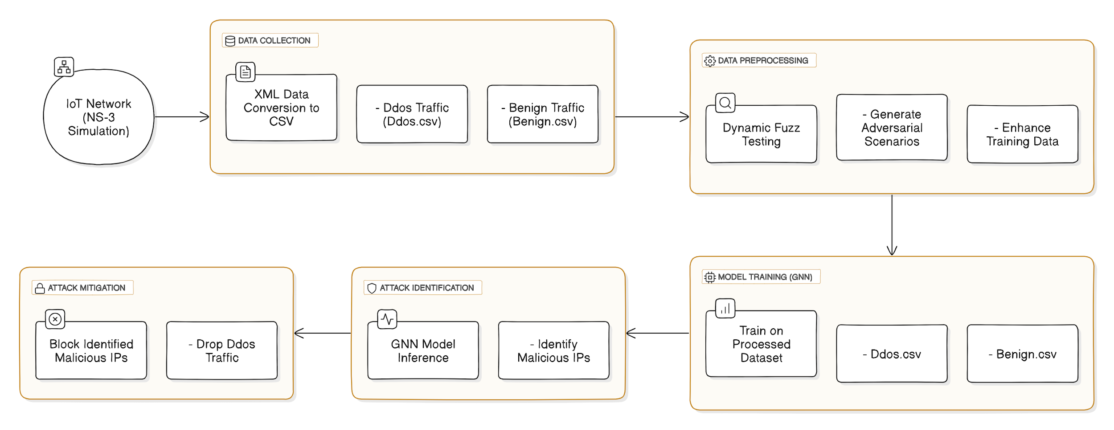
ARCHITECTURE DIAGRAM

Slide 11
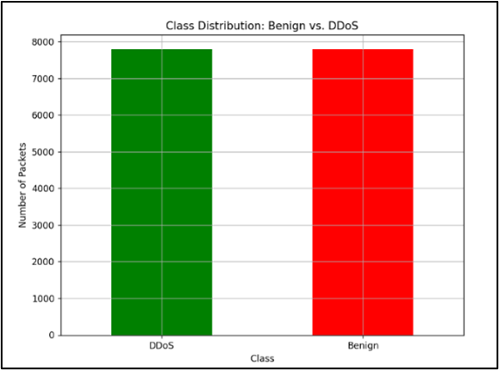
NS3 Data Generation
Traffic Data Collection: Simulation logs all network traffic via router in XML format, capturing both benign (IoT) and malicious (bot nodes) traffic.
XML to CSV Conversion:
In-house scripts convert XML logs to CSV for easier machine learning usage.
Extracted features: timestamp, source/destination IP, packet size, etc.
Labelled packets as "Benign" or "DDoS" based on source.
Data Balancing: Balanced benign and DDoS packets to prevent model bias.
Data Class Distribution

Slide 12
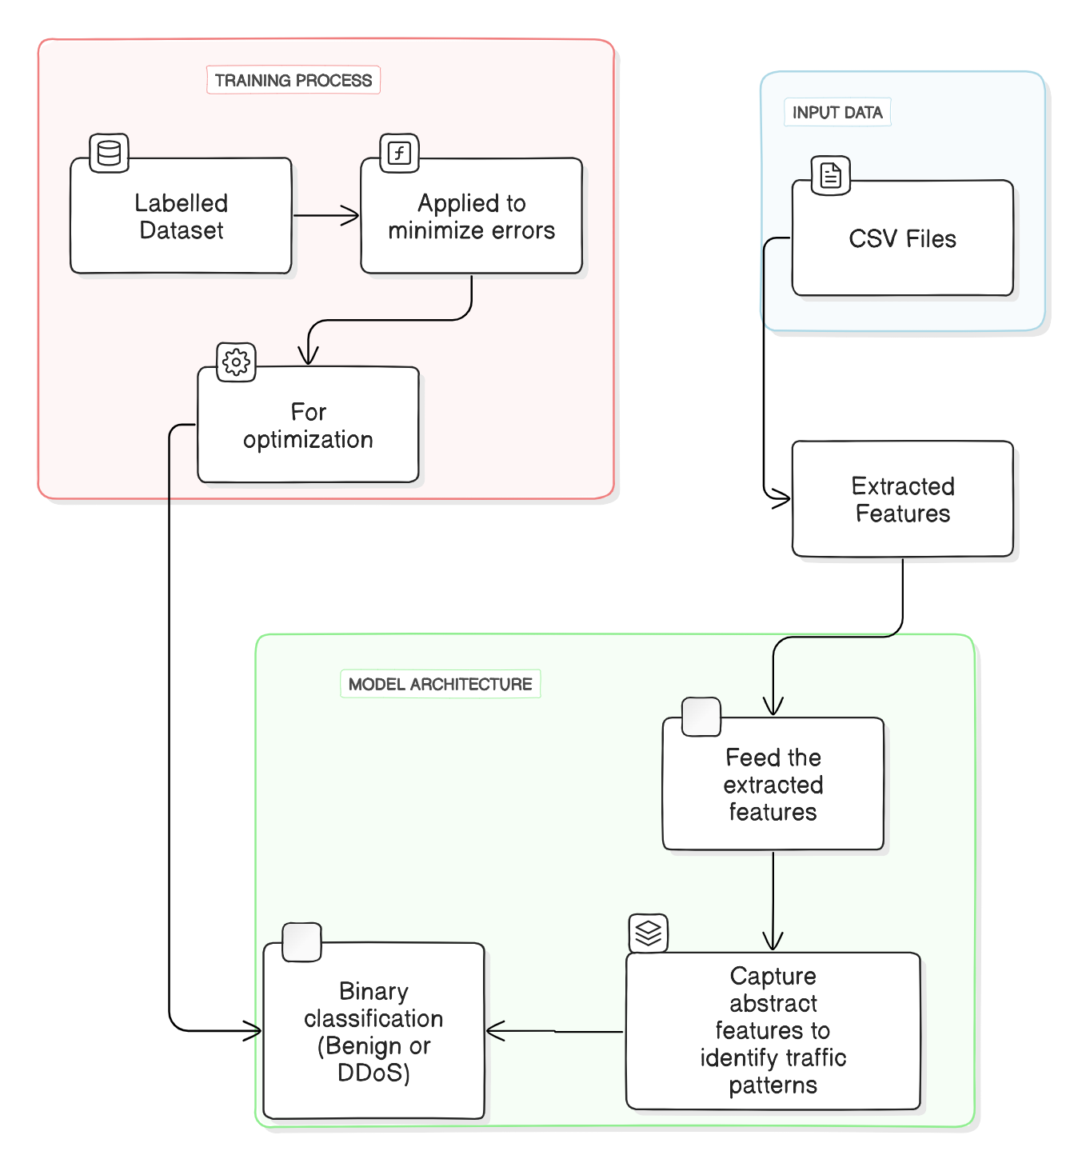
GNN Model Overview
Model Input
Features: Packet count, source/target IPs (from CSV files)
First layer processes raw features from traffic data
Hidden Layers
Capture complex relationships and subtle patterns
Distinguish between normal traffic and DDoS attacks
Output Layer
Binary classification: "Benign" or "DDoS"

Slide 13
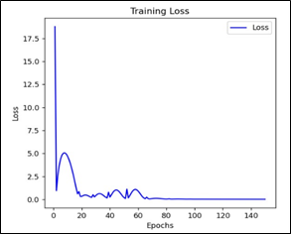
GNN Model Training
Training Process
Labelled dataset used to train the model
Loss function applied to reduce errors in each epoch
Hyperparameter Tuning
Optimized layers, learning rate, batch size, etc.
Multiple sessions used to find the best settings
Validation
Validation set used after each epoch to prevent overfitting
Adjustments made based on validation results
Model training loss

Slide 14
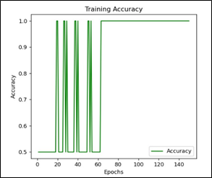
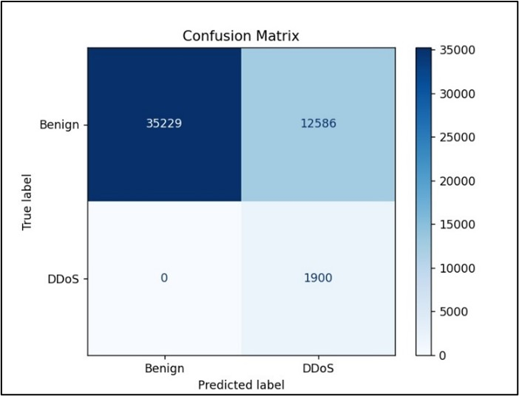
GNN Model Performance
Accuracy for GNN Model is 74%.
Model training accuracy
Confusion Matrix

Slide 15
Mitigation Strategy: Dynamic Packet Filtering
Dynamic Packet Filtering: Selected for its ability to provide real-time, automated responses.
Real-Time Detection: The GNN model quickly identifies and addresses DDoS packets.
Dynamic Blocklist: Automatically updates with newly detected malicious IPs.
Router-Level Filtering: Filters out packets from blocklisted IPs at the router level, preventing server overload.
Network Stability: Reduces harmful traffic to ensure consistent network performance.

Slide 16
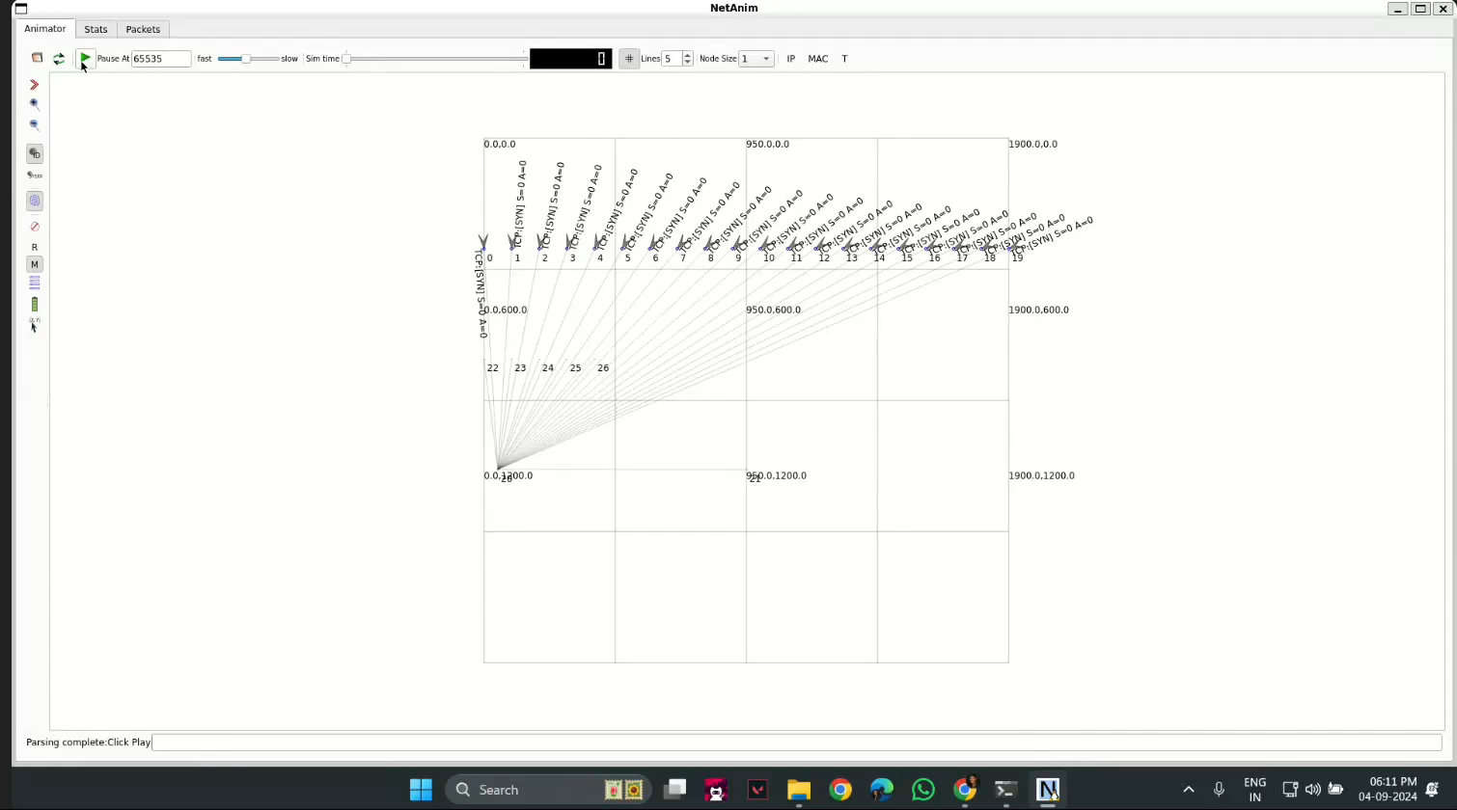
Simulation

Slide 17
Thank You!

